Slide 1


Paradrogue Aerodynamics Research: CFD Modeling and Wind Tunnel Testing

Slide 2
By Forrest Mobley
Aerospace Engineering
mobleyf@my.erau.edu
Mentored by Dr. Hayashibara
College of Engineering

Slide 3
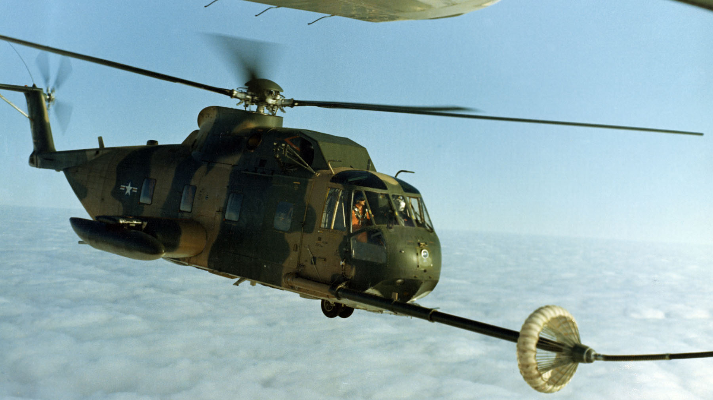
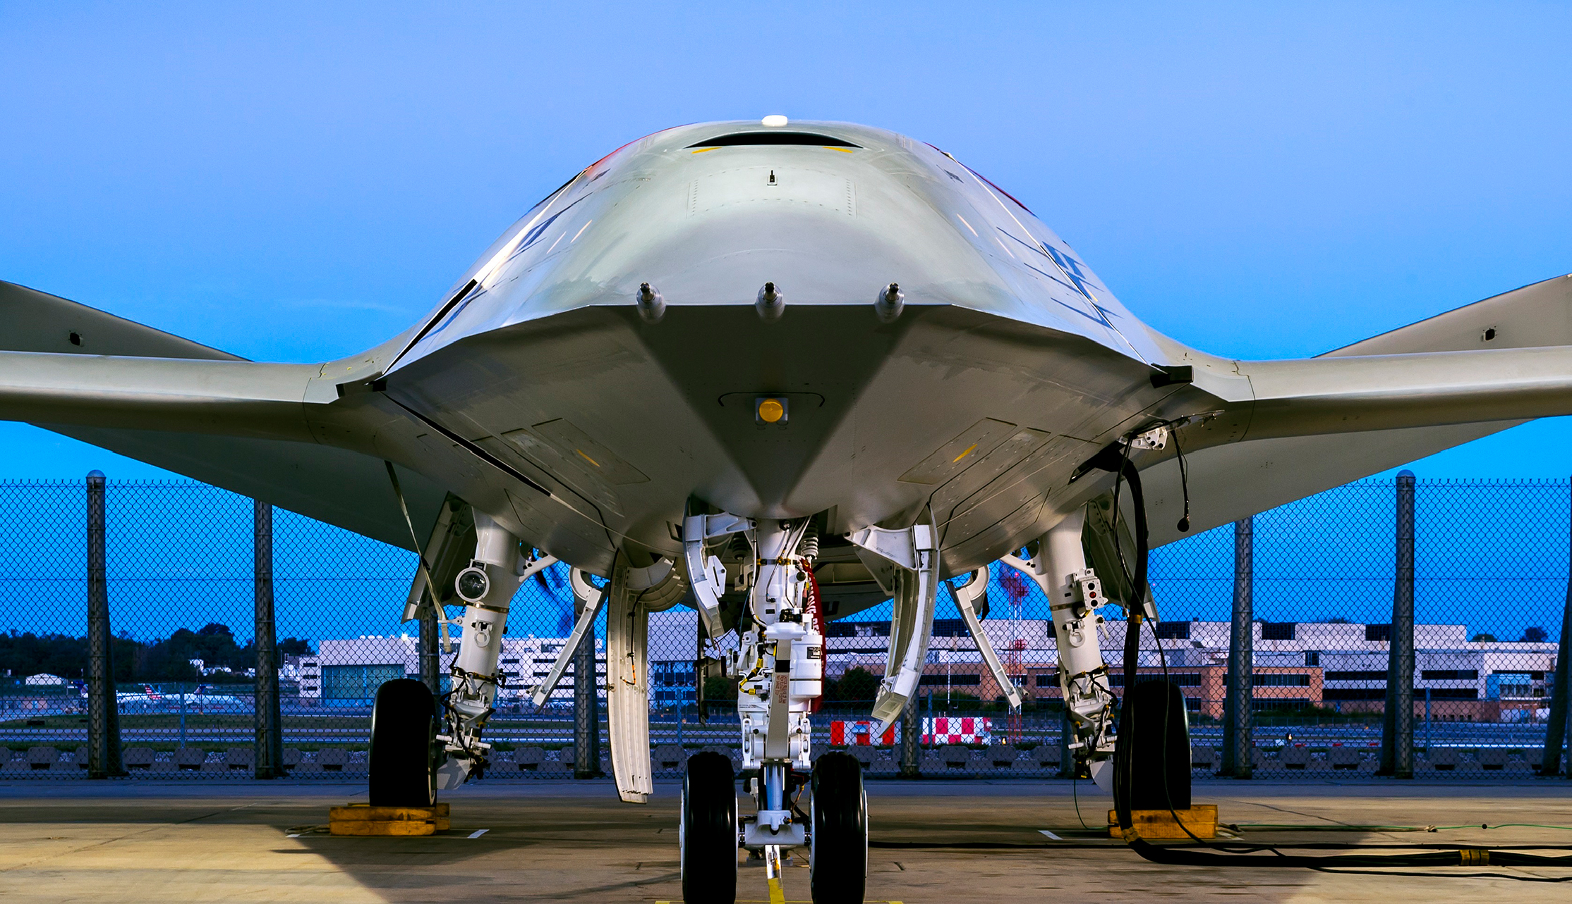
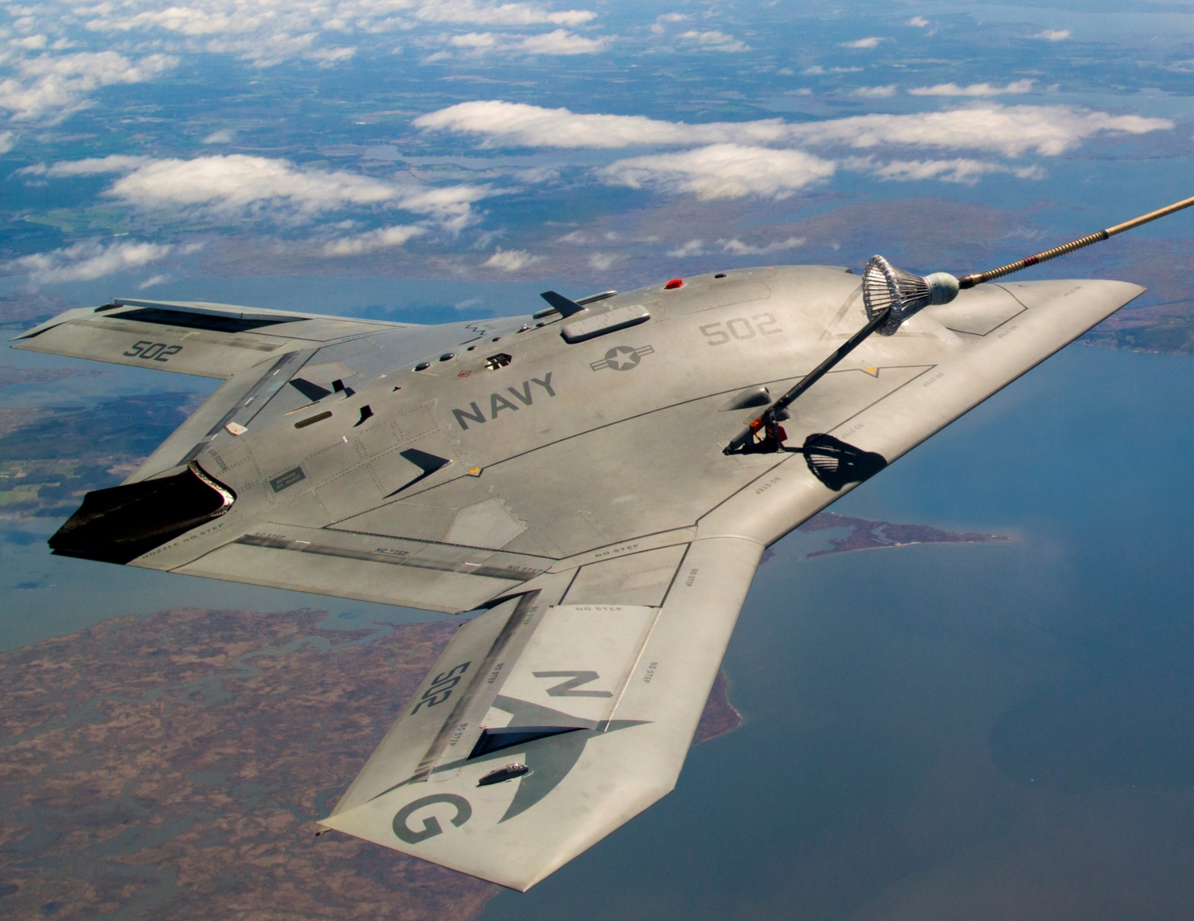
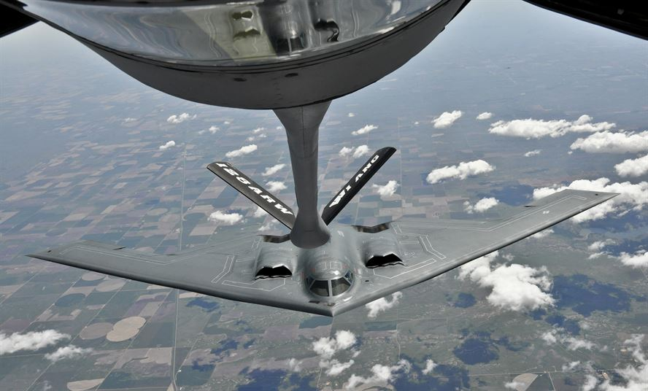
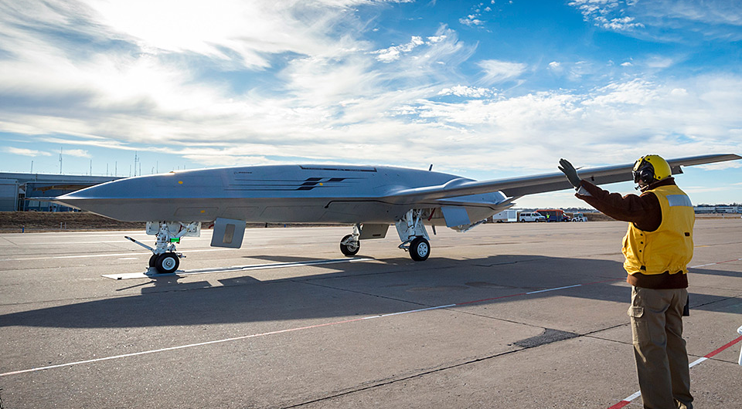
Aerial Refueling & Drones
(U.S. Air Force, 2018)
(Eckstein, 2017)
(Northrop Grumman, 2018)
(U.S. Air Force, 2018)
(Boeing, 2019)
Notes:
Applying Paradrogue Tech to UAVs, and increasing stability

Slide 4
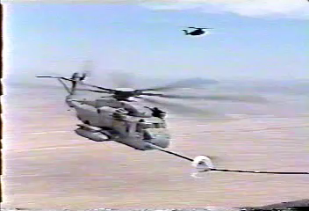
Increasing Stability
Notes:
Helicopter Video

Slide 5
Methods
Wind Tunnel Testing
Analytical
Experimental
Effects of Chute Geometry
Numerical
CFD

Slide 6

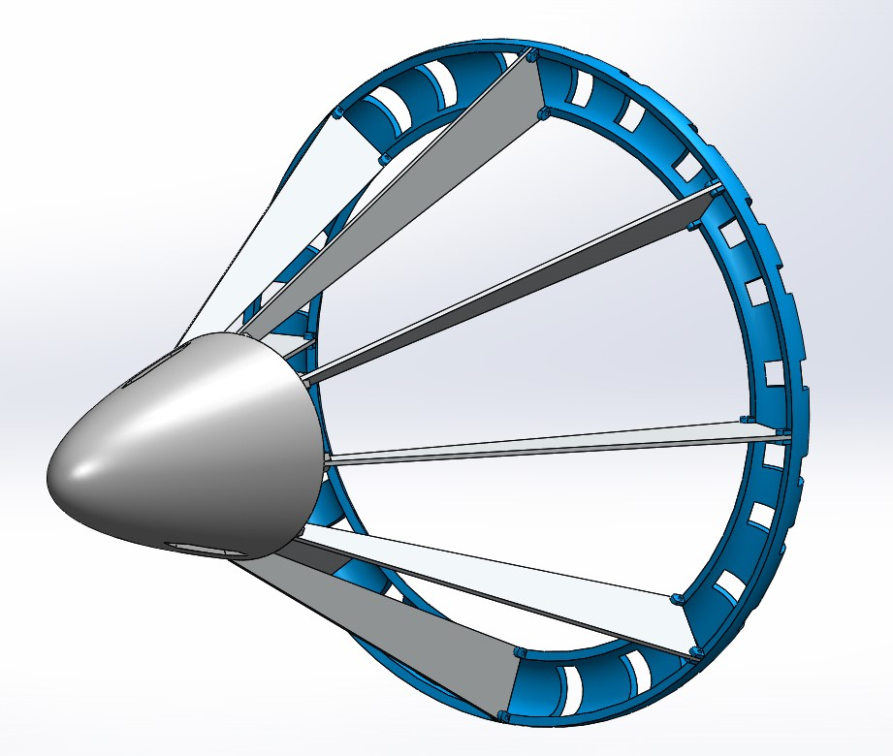
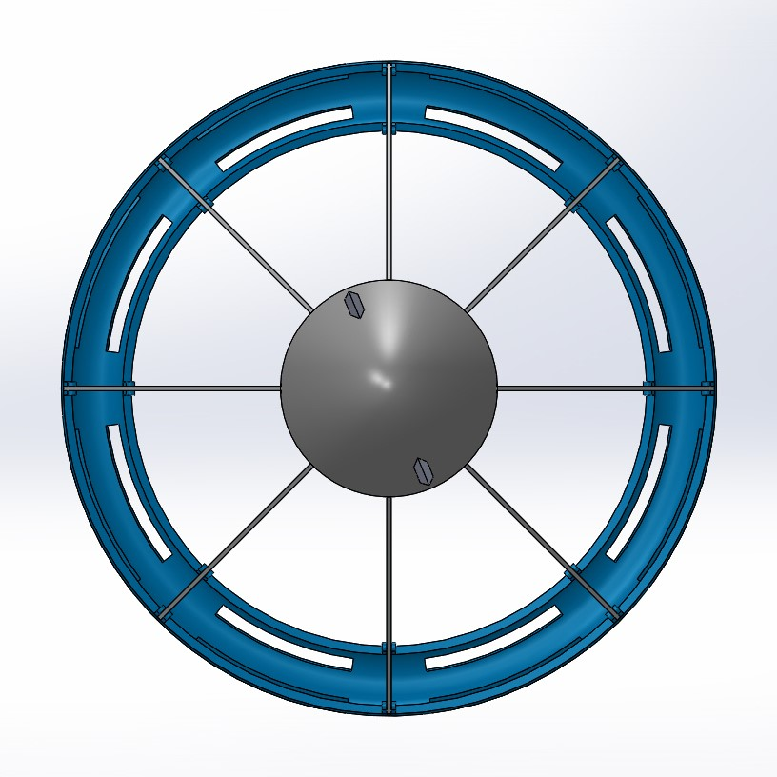
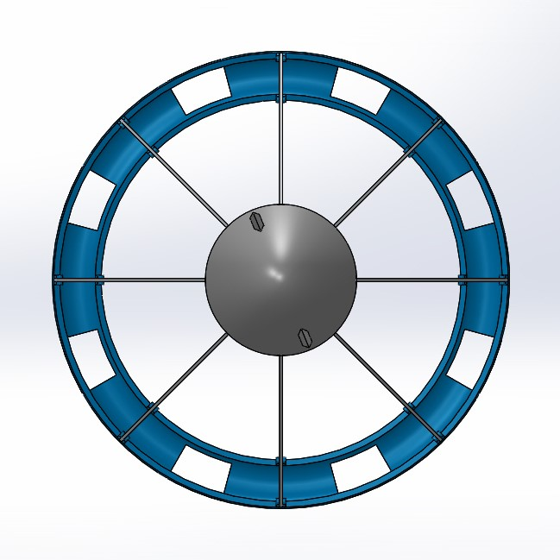
Geometry – Scaled Paradrogue
Geometric Details:
Chute Diameter: 9 in
Chute Ring Diameter: 1 in
Nose Cone Diameter: 3 in
Nose Cone Length: 4.5 in
Overall Length: ~ 11 in
Rectangular – Unevenly Spaced
Stripes
Rectangular – Evenly Spaced

Slide 7
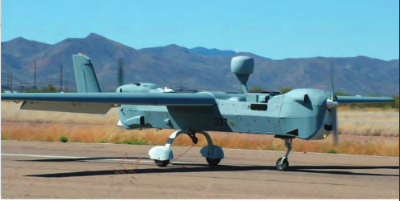
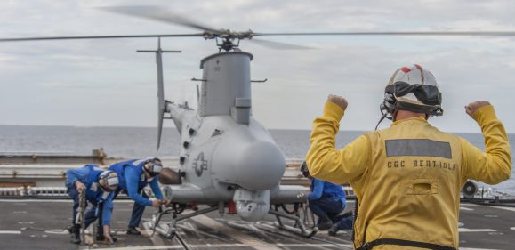
Paradrogue Simulation Conditions
(Northrop Grumman, 2018)
(Northrop Grumman, 2018)
MQ-5B Hunter
Flight Speeds: 60 – 120 knots
Wing Span: 34.25 ft
Endurance: 21 hours
MQ-8B Fire Scout
Flight Speeds: 85 knots
Rotor Diameter: 27.5 ft
Endurance: 595 nmi or 7.75 hours

Slide 8
Drag Coefficient Results
Model | Wind Tunnel Drag Coefficient* | CFD Drag Coefficient* | Percent Difference
Unevenly Spaced Rectangular | 1.16 | 0.93 | 19.80%
Evenly Spaced Rectangular | 1.12 | 1.21 | 8.12%
Stripes | 1.12 | 1.03 | 8.08%
* Drag Coefficient of Chute Only

Slide 9
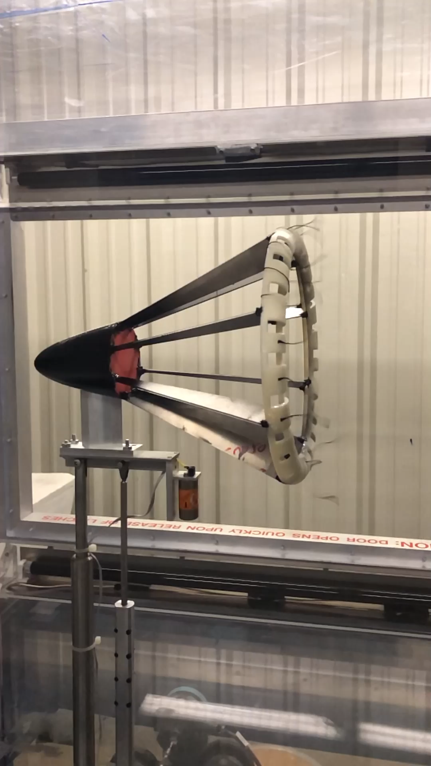
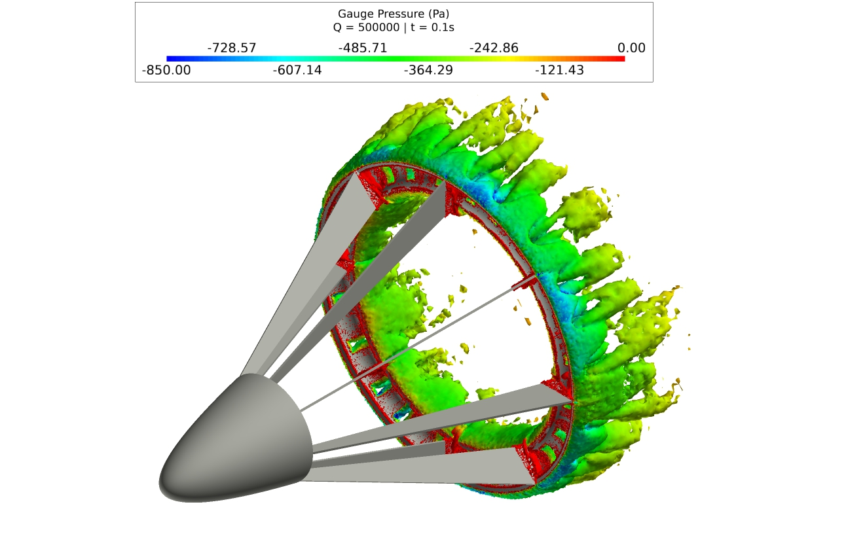
Model Behavior: Uneven Model

Slide 10
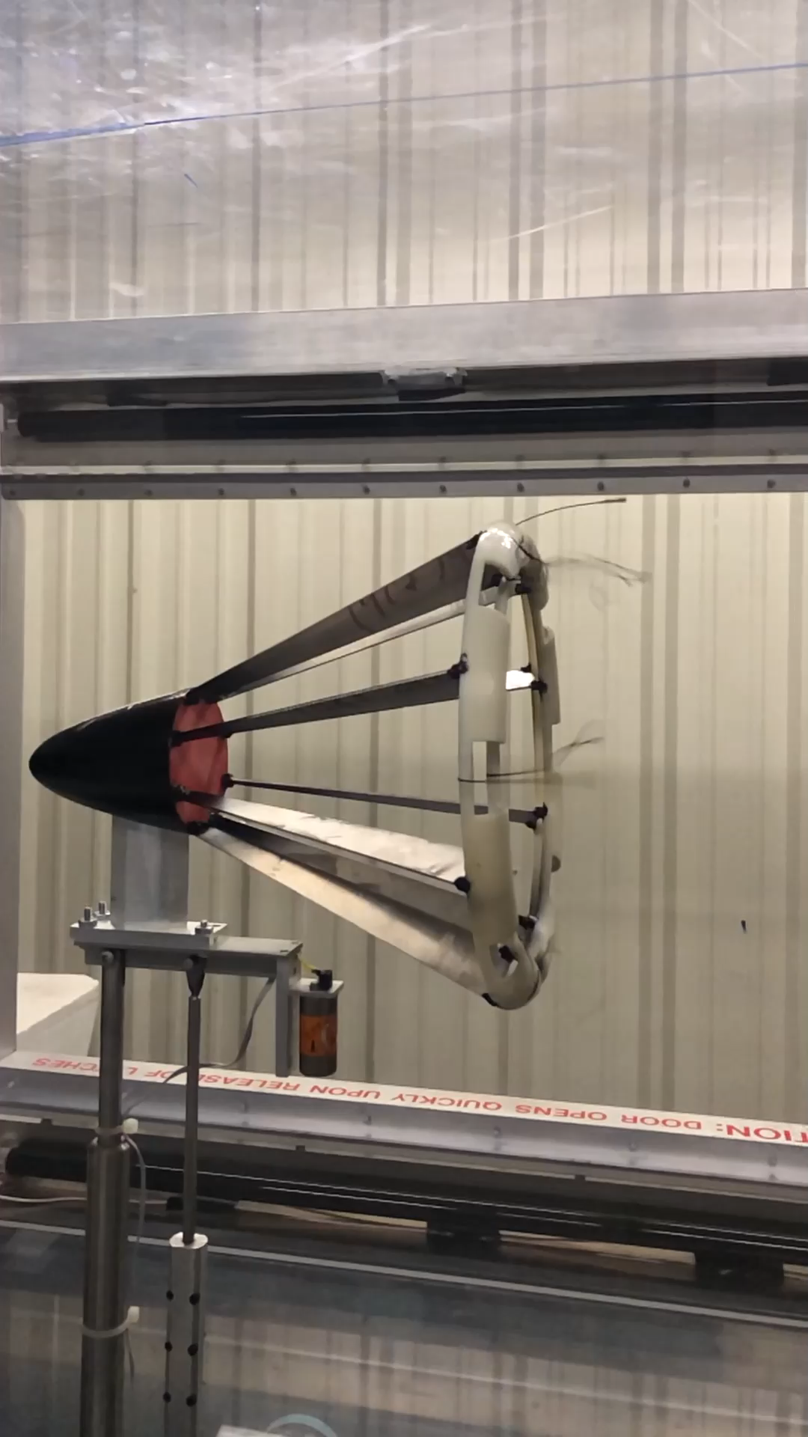
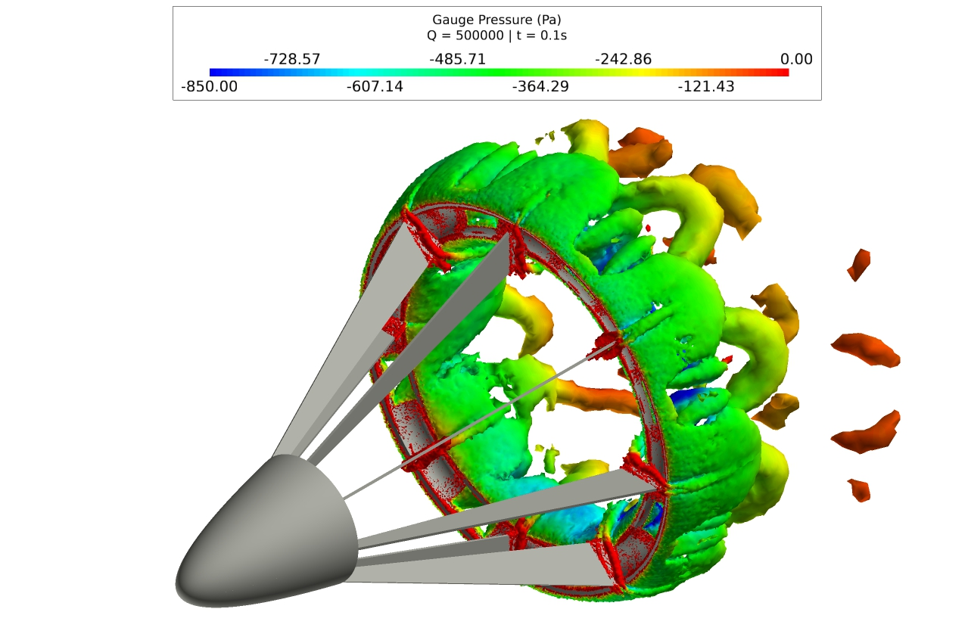
Model Behavior: Even Model

Slide 11
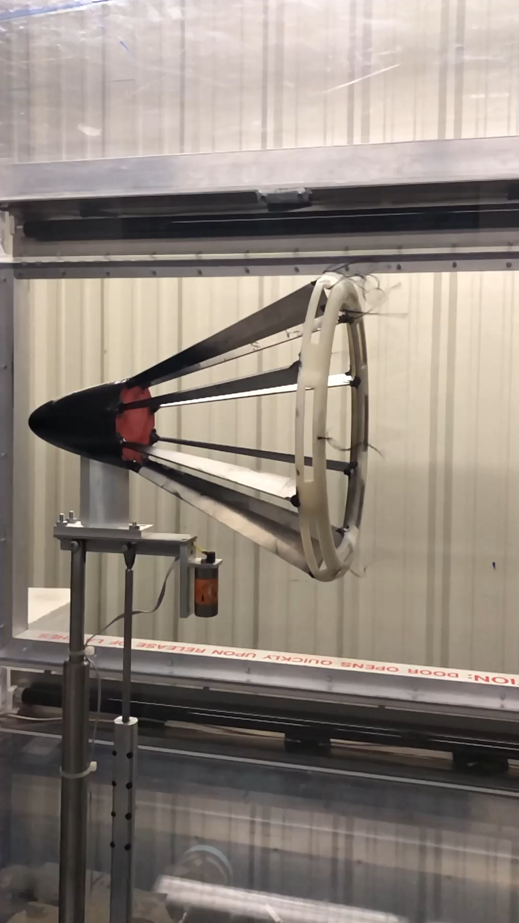
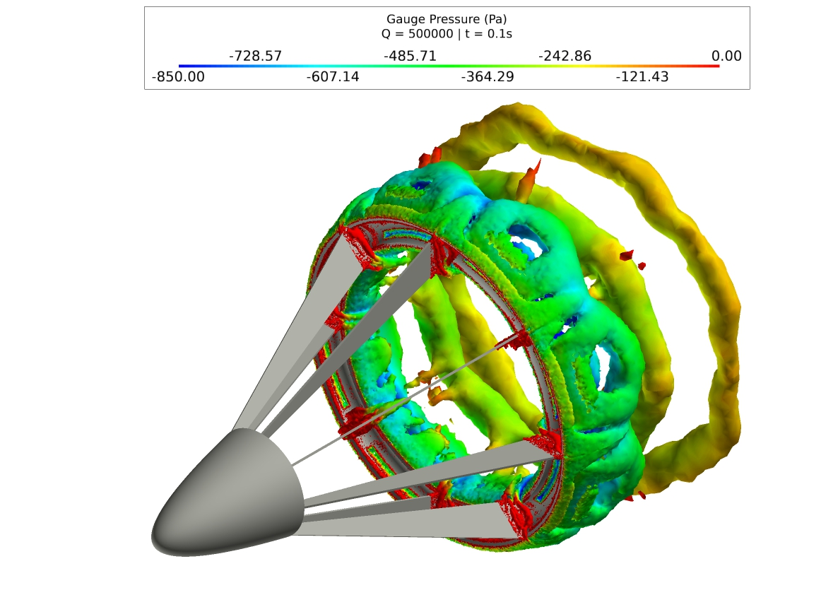
Model Behavior: Stripes Model

Slide 12
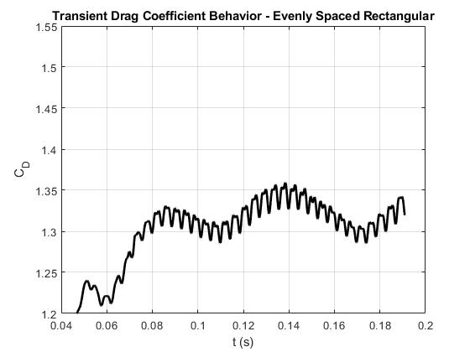
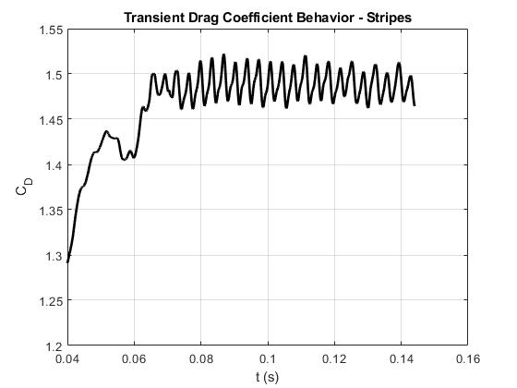
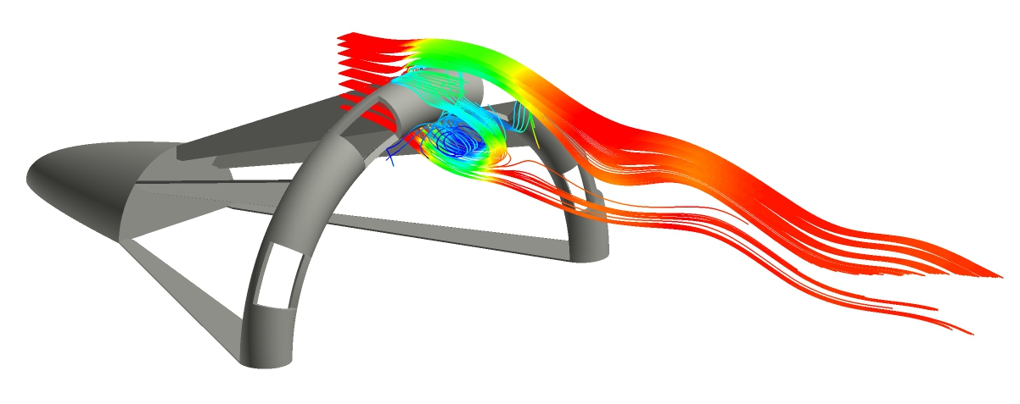
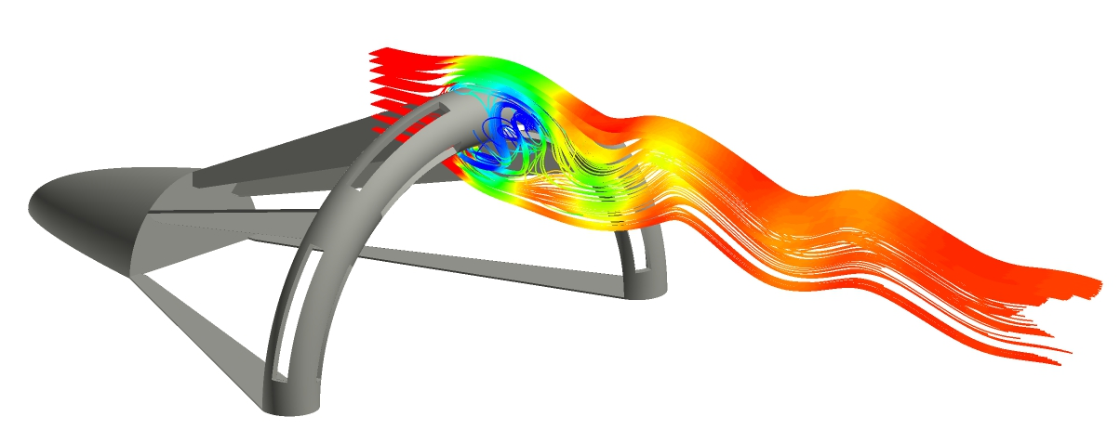

Model Comparison: Even and Stripes Models
Strouhal Number
$$S=\frac{fL}{U}$$
Both models have same Strouhal number
However, shedding quality is very different

Slide 13
Future Plans
Range of Freestream Velocities: Reynold’s Number
  Wind Tunnel Testing
  CFD Models
    Both Wind Tunnel and Farfield boundary conditions
Different Geometrical Aspects
  Struts: Changing Incidence Angle of Chute
  Nose Cone: Increasing realism by changing shape & adding refueling hose

Slide 14
Questions

Slide 15
Works Cited
Boeing. (2019, March 22). MQ-25 Ready for the mission, the flight deck, the U.S. Navy. Retrieved from Boeing: https://www.boeing.com/defense/mq25/
Eckstein, M. (2018, December 19). Boeing Unveils Its MQ-25A Stingray Entry Ahead of Jan. 3 Deadline for Proposals. Retrieved from USNI News: https://news.usni.org/2017/12/19/boeing-unveils-mq-25a-stingray-entry
Northrop Grumman. (2019, March 21). MQ5B Hunter. Retrieved from Northrop Grumman: http://www.northropgrumman.com/Capabilities/MQ5BHunter/Pages/default.aspx
Northrop Grumman. (2019, March 29). MQ-8B Fire Scout. Retrieved from Northrop Grumman: http://www.northropgrumman.com/MediaResources/Pages/Photo.aspx?pid%3DMQ-10027_022%26rel%3D%2F%26name%3DPhotos
Northrop Grumman. (2019, March 28). X-47B UCAS makes history...again! Retrieved from Northrop Grumman: http://www.northropgrumman.com/Capabilities/x47bucas/Pages/default.aspx
U.S. Air Force. (2019, March 29). Disengaging from the boom. Retrieved from Air National Guard - 128th Air Refueling Wing: http://www.128arw.ang.af.mil/News/Photos/igphoto/2000152100/
U.S. Air Force. (2019, March 29). Sikorsky HH-3. Retrieved from National Museum of the US Air Force: http://www.nationalmuseum.af.mil/Upcoming/Photos/igphoto/2000306813/

